Slide 1
Project Report
Anirudh (094)
Pranav Kondala (106)
Pranav Nath (107)
13th March 2014

Slide 2
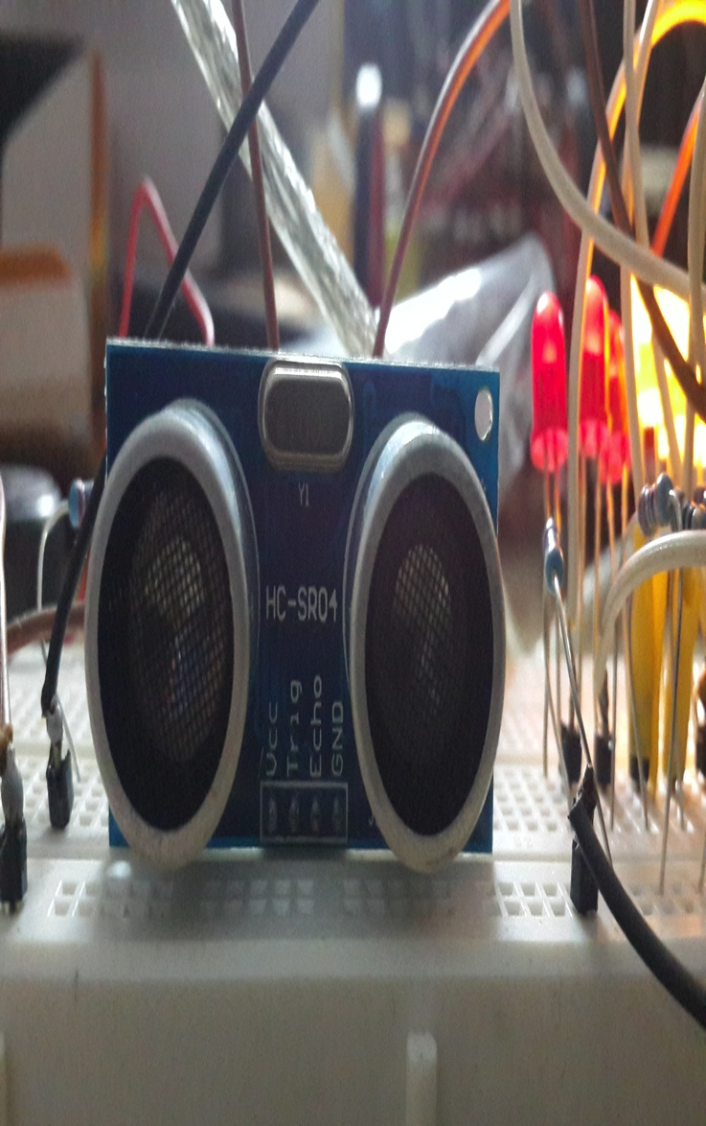
Project Overview
Assist in automobile breaking by providing visual, audio warning and automated braking system using ultrasonic sensors.
To Provide a better, safer and economical brake assist system for vehicles .
Saving lives by avoiding major accidents on roads and making roads a safer place to travel.
Notes:
What is the project about?
Define the goal of this project
Is it similar to projects in the past or is it a new effort?
Define the scope of this project
Is it an independent project or is it related to other projects?
* Note that this slide is not necessary for weekly status meetings

Slide 3
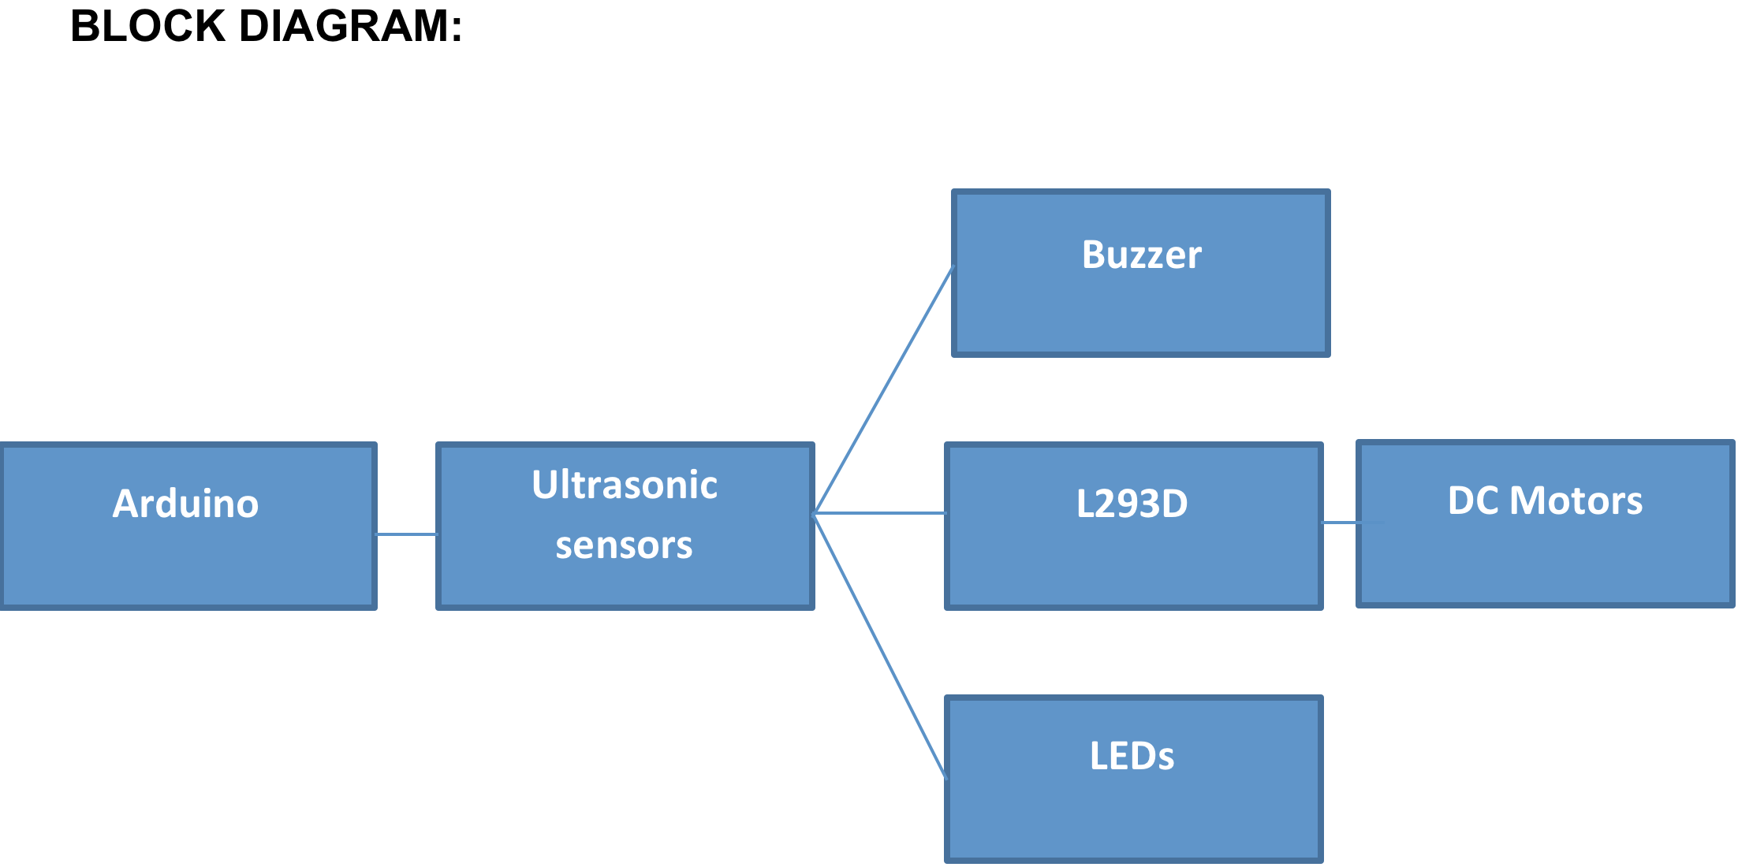

Slide 4
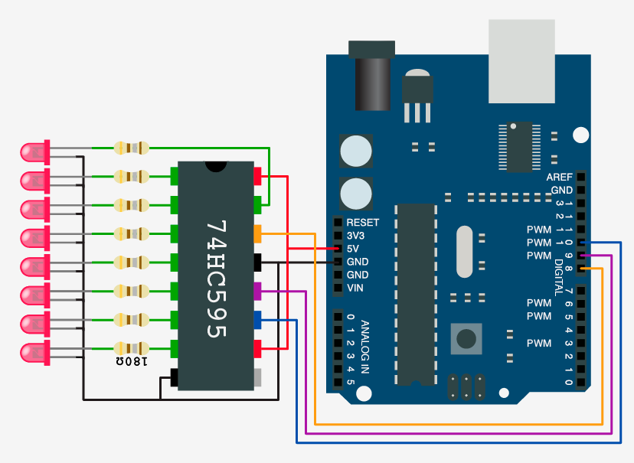

Slide 5
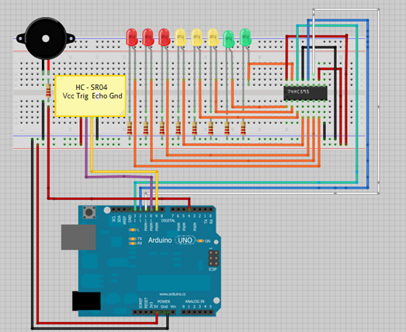

Slide 6
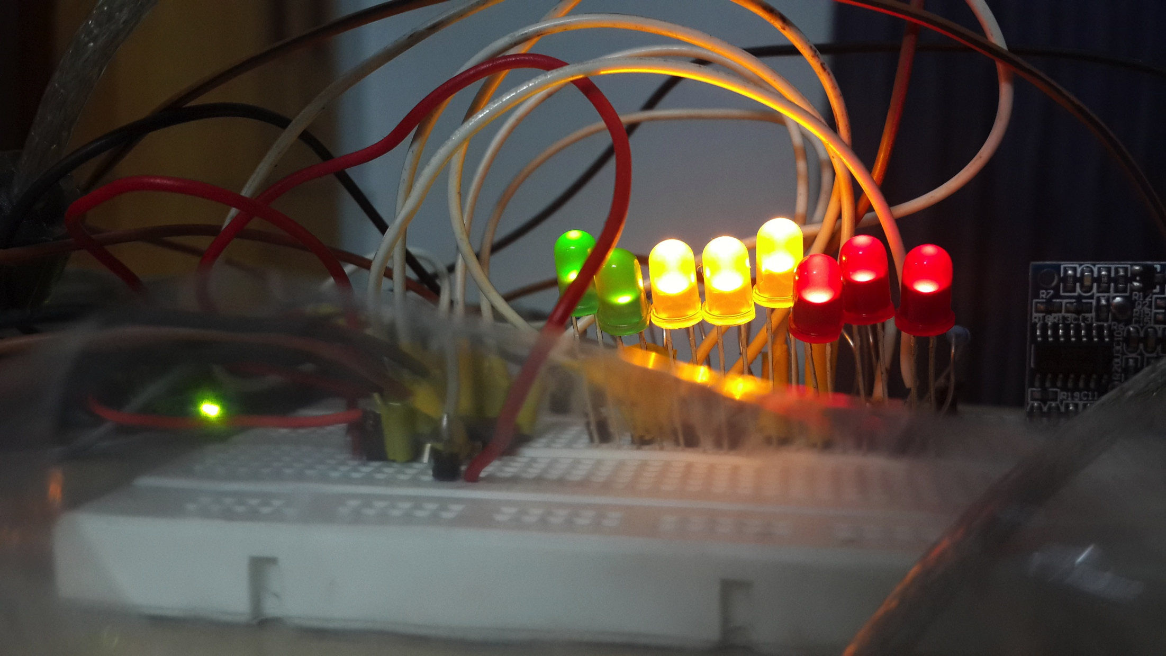
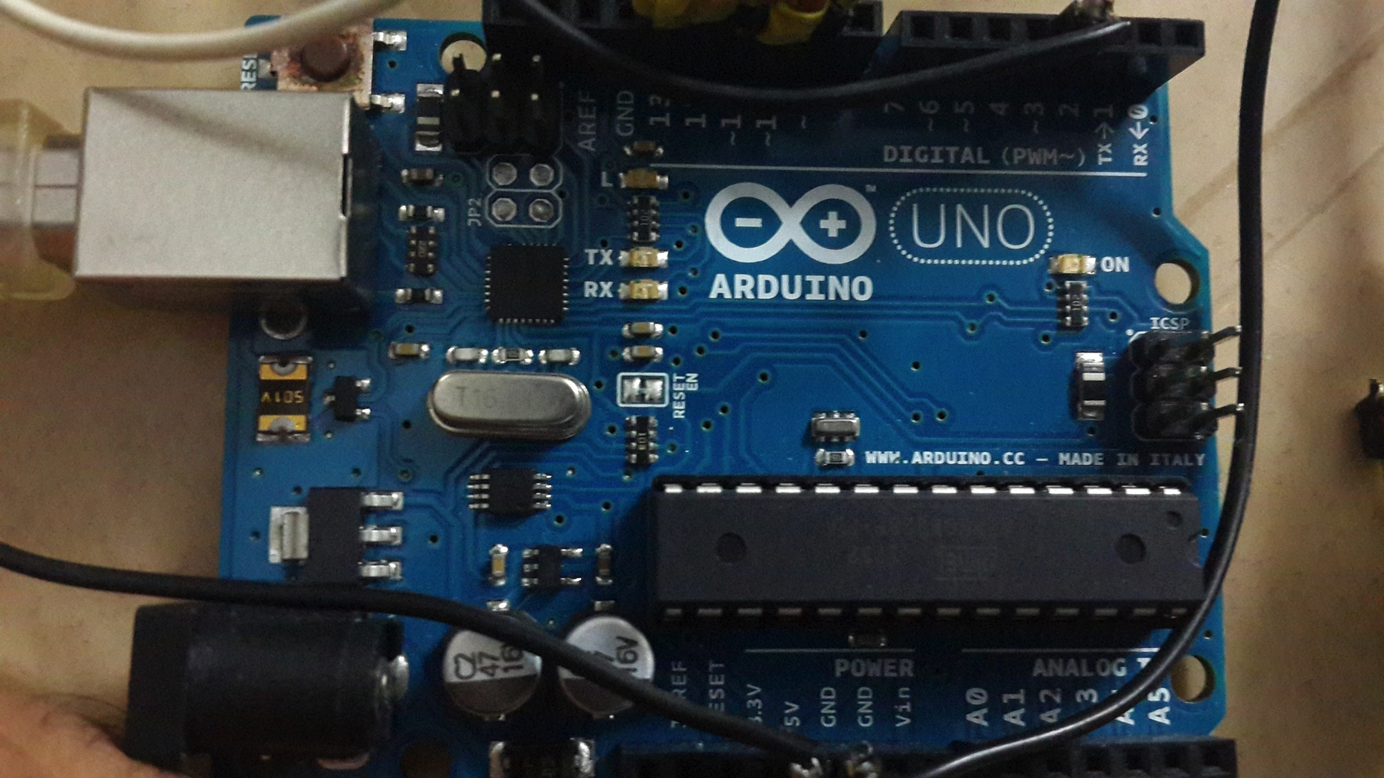

Slide 7
